Slide 1
Automated Service Case Management using Salesforce, OCR & AI PPT-2
BY:
NIMISHA MALLERI(EN22IT301062)

Slide 2
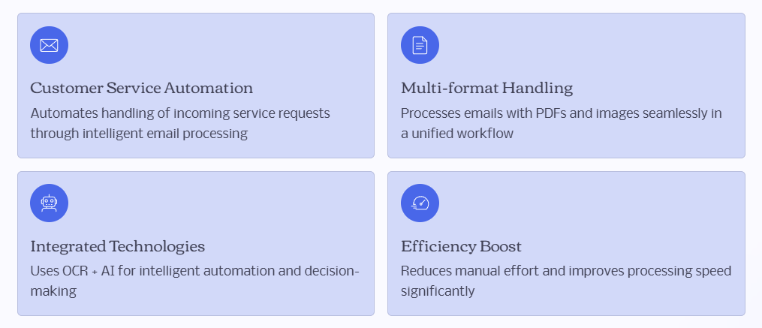

Project Overview

Slide 3

THE BUSINESS PROBLEM
Manual Case Creation: Inefficient process for converting emails into service cases.
Manual Document Review: Time-consuming review of images and PDFs for critical information
Lack of Auto-Classification:Absence of automated systems to categorize cases effectively.
Delayed Responses & Risks:Increased response times leading to potential Service Level Agreement (SLA) breaches.

Slide 4
PROJECT OBJECTIVE
Automated Case Creation : Implement Email-to-Case for seamless case generation.
OCR-Powered Data Extraction: Extract relevant text from various document formats (images, PDFs).
Salesforce Data Integration: Store all extracted OCR data directly within Salesforce records.
AI-Driven Classification: Utilize AI for accurate case categorization and priority assignment.
Reduced Manual Effort: Minimize human intervention in routine case management task.

Slide 5
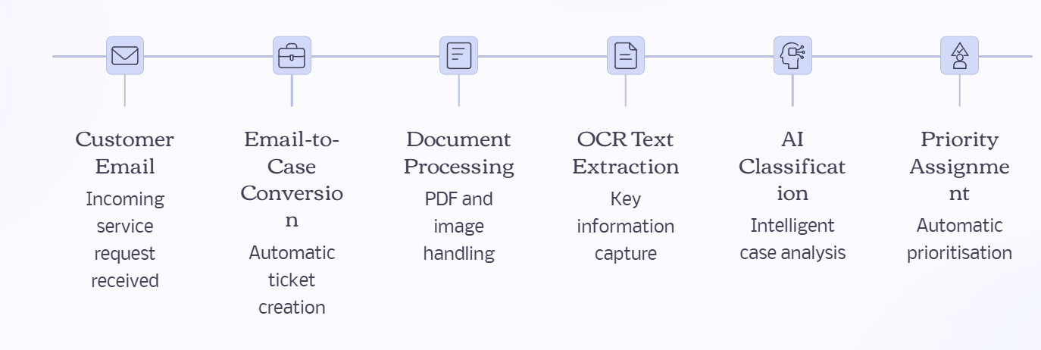
END TO END ARCHITECTURAL FLOW

Slide 6
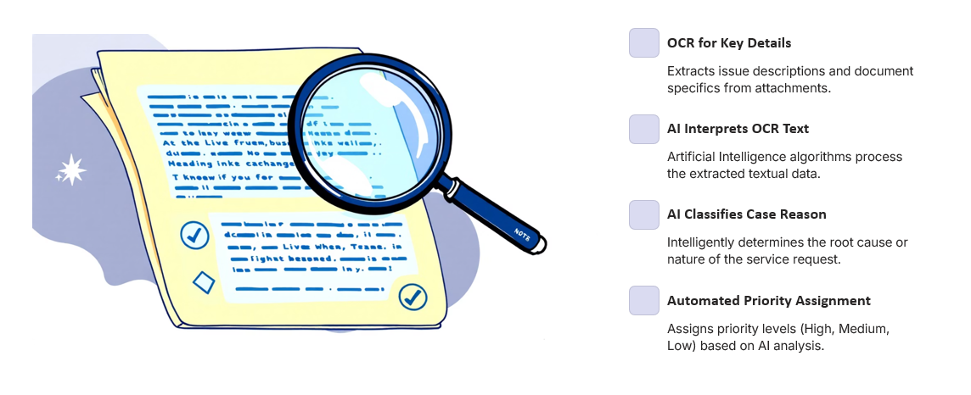
AI AND OCR WORKING

Slide 7
EXAMPLE USE CASE

Slide 8
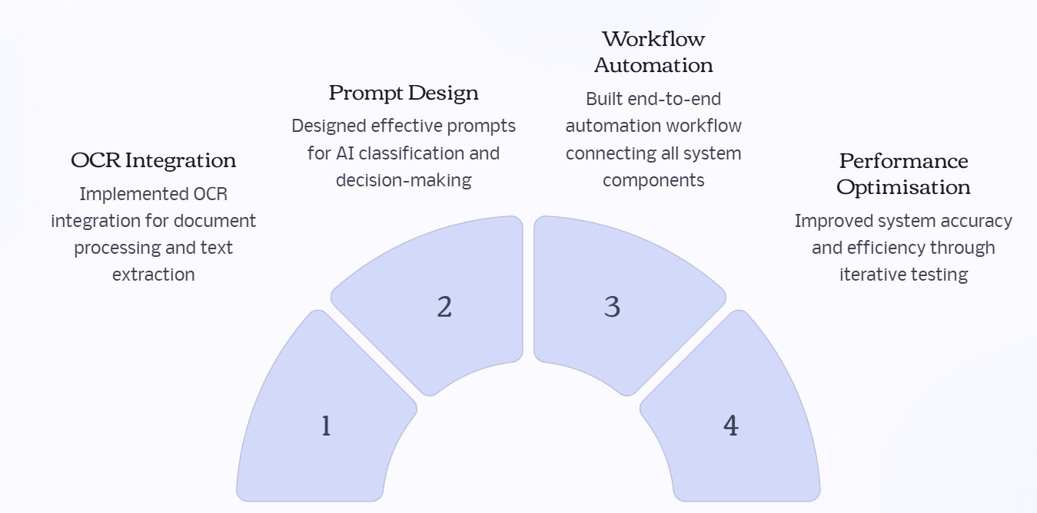
MY CONTRIBUTION

Slide 9
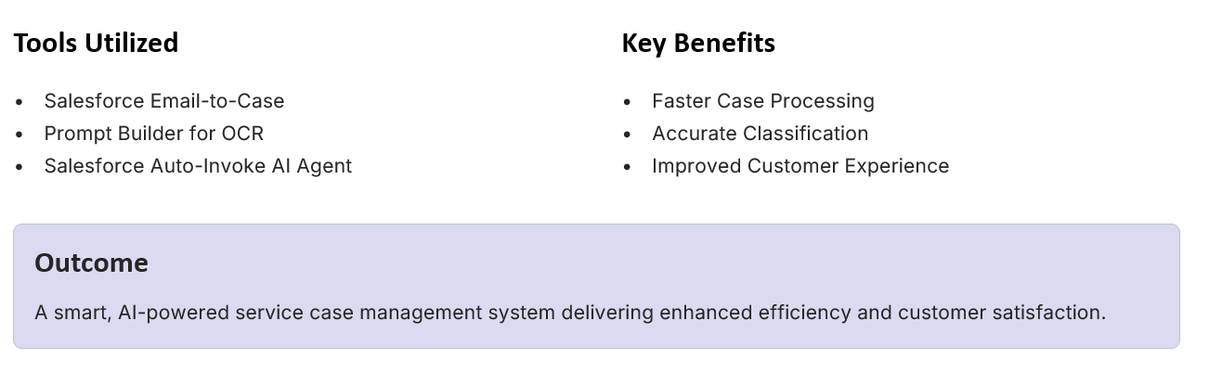
TOOLS BENIFITS AND OUTCOME

Slide 10
Thank You!
For any query/suggestions pls mail us at
en22it301062@medicaps.ac.in

